Slide 1
Unit 66 - Task 3
Salford City College – Future Skills
By joseph roper

Slide 2
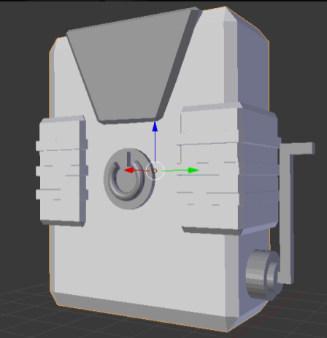
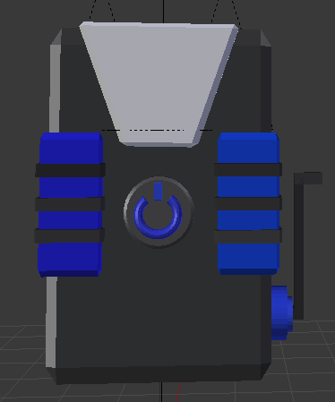
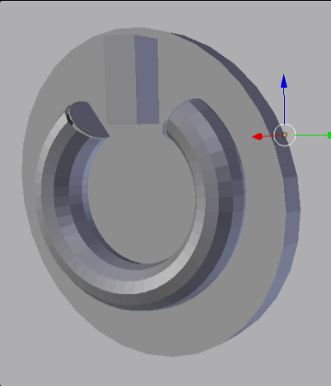
Model 1 – Finished Model
This model is made up of entirely cuboids which have been altered in various ways. For the main body I added a bevel modifier to the object making it look less blocky and more smooth. For the rest of the model I either changes the size of the object or manipulated the vertices to change the objects original shape. Currently the torch cannot produce light but I will fix that later by adding a lamp to the object the should produce light. For this asset I used the box modelling technique as I believe it suits my designs.

Slide 3
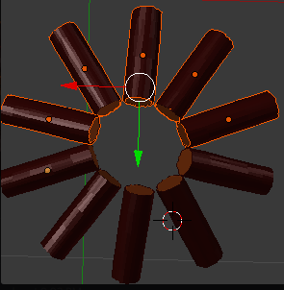
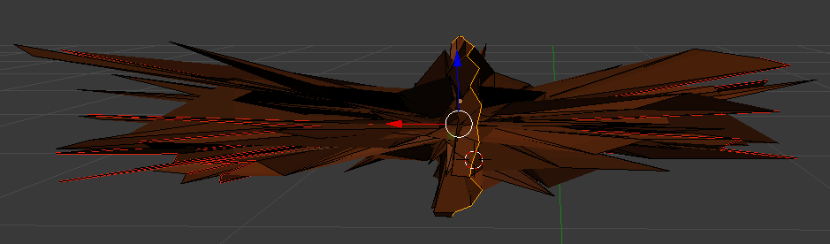
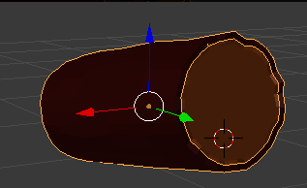
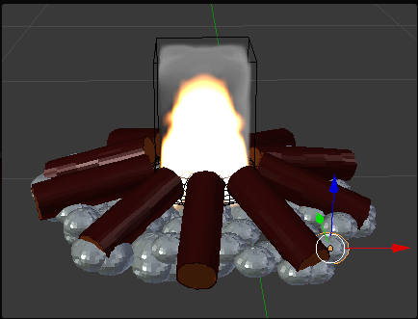
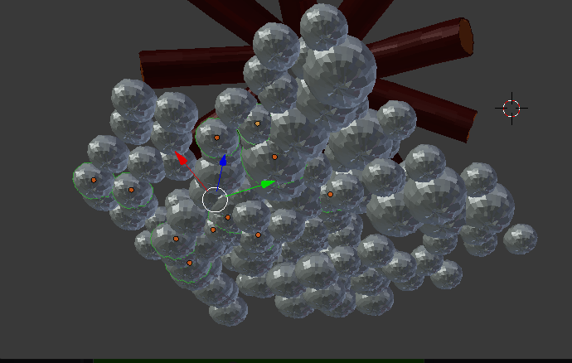
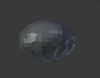
Model 2 – Finished Model
This model is made up of spheres which have been compressed for the rocks and cylinders for the logs which have had their vertices slightly compressed to make the exterior look rugged. Lastly I added a smoke and fire effect to a compressed sphere in the middle to represent the fire aspect. In the future I will add a spiral on the inside of the log to make it more realistic. For this asset I used the box modelling technique as I believe it suits my designs.

Slide 4
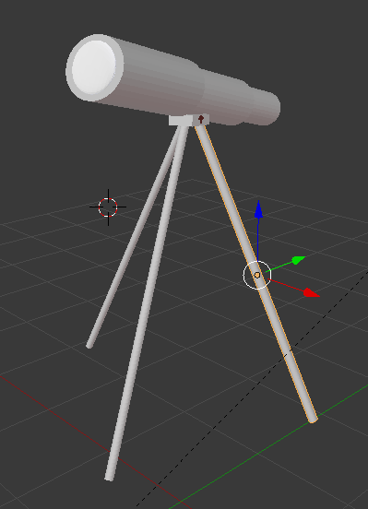
Model 3 – Finished Model
This model is nearly entirely made out of cylinders apart from a sphere for the glass, a cuboid for the stand and lastly a monkey head for the logo. The sphere representing the magnifier on the telescope has a worn out glass material added on to it making it seem at closer inspection this item has been shipwrecked for a long time. In the future I will add colour and textures to the rest of the parts making certain part a scratched gold effect and the rest to look like waterlogged wood. For this asset I used the box modelling technique as I believe it suits my designs.

Slide 5
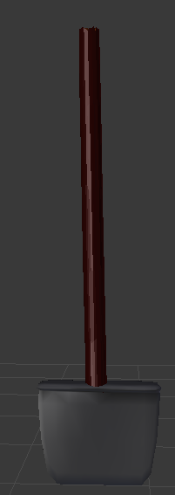
Model 4 – Finished Model
For this model I recycled the previous wooden log and stretched it out to make it look more like a stick. Then I got a cuboid and changed the properties of the vertices to get this peculiar looking spade head. I then added a sort of dirty steel colour to the spade head. For this asset I used the box modelling technique as I believe it suits my designs.

Slide 6
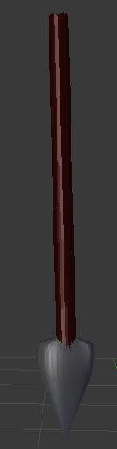
Model 5 – Finished Model
For this model I recycled the previous wooden log and stretched it out to make it look more like a stick. Then I used a cone and stretched it a bit to make it look more like a spear. I then added a sort of dirty steel colour to the spear head. For this asset I used the box modelling technique as I believe it suits my designs.

Slide 7
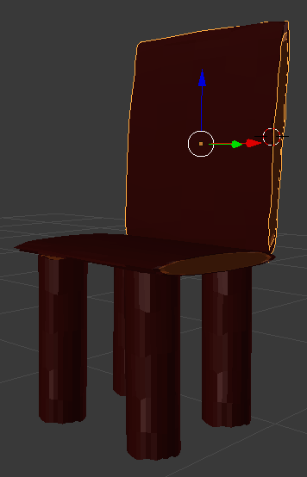
Model 6 – Finished Model
For this model I recycled the previous wooden log and stretched it out to make it look more like the legs, seat and back of the chair. For this asset I used the box modelling technique as I believe it suits my designs.

Slide 8
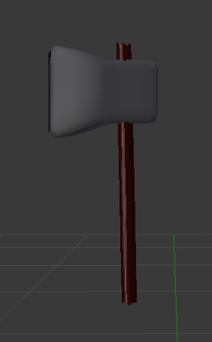
Model 7 – Finished Model
For this model I recycled the previous wooden log and stretched it out to make it look more like a stick. Then I used a cuboid and changed the properties of the vertices to make it look more like a axe head. I then added a sort of dirty steel colour to the axe head. For this asset I used the box modelling technique as I believe it suits my designs.

Slide 9
Conclusion
Overall I am happy with the models I have created and believe they look like my initial designs on paper. I experienced a lot of problems with the 3D modelling software I was using mainly to do with me not being used to the controls meaning that I would accidently press a button causing all of my work to disappear then I would spend at least 10 minutes trying to get it back. I would have liked to spend longer on my models and become more familiar with Blender the modelling software I used, however due to time constraints I couldn’t.

